Slide 1
Lesson 5: Operators
By: Ryan Alterman
Revised: 9-1-17

Slide 2
What is an Operator?
Used to perform mathematical or logical manipulations
Basically, logic statements and math.
Types of Operators:
Arithmetic
Relational
Logical
Assignment
Miscellaneous
Note: There are operators called bitwise operators. We will most likely never use these, so I will mention they exist but will not be covered in this lesson.

Slide 3
Arithmetic Operators
Addition( + )
Takes two numbers and adds them
Subtraction ( - )
Subtracts the second number from the first
Multiplication ( * )
Multiplies two numbers
Division ( / )
Divides the numerator by the denominator
Remainder( % )
Takes the remainder two numbers and displays that
Increment ( ++ )
Adds one ot the value
Decrement ( -- )
Subtracts one from the value

Slide 4
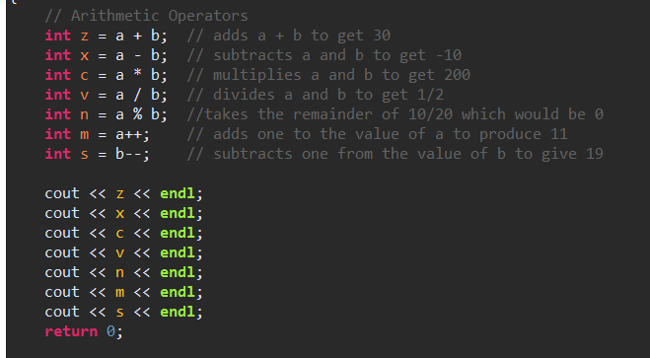
The use of arithmetic operators.

Slide 5
Relational Operators
Equal to ( == )
Checks if two values are equal; outputs boolean
Not Equal ( != )
Checks if two values are not equal; outputs boolean
Greater Than ( > )
Checks if the value to the left is greater than the right; outputs boolean
Less Than ( < )
Checks if the value to the left is less than the right; outputs boolean
Greater Than or Equal To ( >= )
Checks if the value to the left equals or is greater than the left; outputs boolean
Less Than or Equal To ( <= )
Checks if the value to the left is equal or less than the right; outputs boolean

Slide 6
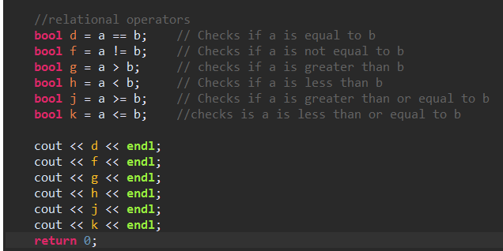
How to use the Relational Operators

Slide 7
Logical Operators
These check for values that are greater than 0
AND ( && )
If both the values are not zero; it will output true
BOTH VALUES HAVE TO BE THE SAME TO OUTPUT TRUE!
OR ( || )
If either one of the values is not zero; it will output true
EITHER ONE OF THE VALUES HAS TO BE DIFFERENT IN ORDER TO OUTPUT TRUE!
NOT ( ! )
Put in the front of any logical operator to reverse the output of the operation

Slide 8
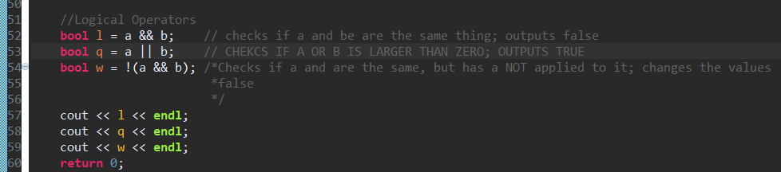
How to use the Logical Operators

Slide 9
Assignment Operators
Equals ( = )
Sets value equal to the values of the right side
Add Equals ( += )
Adds the value of the left to the right and sets the value to the left value.
Subtract And ( -= )
Subtracts the value of the right to the left and sets the value to the left.
Multiply Equals ( *= )
Multiplies the two values and sets the values to the left.
Divide Equals ( /= )
Divides the left values by the right values and sets them to the left value
Remainder Equals ( %= )
Takes the remainder and sets it to the left value

Slide 10
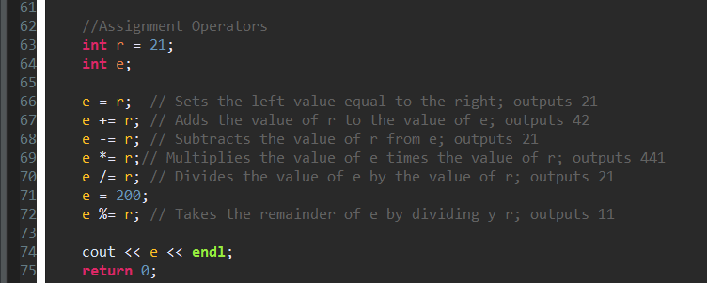
How to use assignment operators

Slide 11
Misc. Operators
Sizeof Operator ( sizeof )
Returns the size of the variable( in bits )
Conditional Operator ( Condition ? X : Y )
If condition is true, returns X value; if not, returns the Y
Comma Operator( , )
Causes a sequence of operation to be performed
Member Operators ( . AND -> )
References individual members of classes, structures, and unions.
Casting Operator (Cast)
Converts the type of a variable into another type; int(2.2) = 2
Pointers ( & AND * )
The & will return the address of the variable
The * will point to the variable itself

Slide 12
Operator Precedence
Operators will be evaluated or looked at first
Ex. 7 + 3 * 2 will not give 20, but 13

Slide 13
Category | Operator | Associativity
Postfix | () [] -> . ++ - - | Left to right
Unary | + - ! ~ ++ - - (type)* & sizeof | Right to left
Multiplicative | * / % | Left to right
Additive | + - | Left to right
Shift | << >> | Left to right
Relational | < <= > >= | Left to right
Equality | == != | Left to right
Bitwise AND | & | Left to right
Bitwise XOR | ^ | Left to right
Bitwise OR | | | Left to right
Logical AND | && | Left to right
Logical OR | || | Left to right
Conditional | ?: | Right to left
Assignment | = += -= *= /= %=>>= <<= &= ^= |= | Right to left
Comma | , | Left to right

Slide 14
Challenge
I want you to use everything that you have learned so far, and operators, to make a functioning calculator. It can do as many different operations as you want, but all I require is the four basic ones. It must be able to add, subtract, multiply, and divide. It must be able to use both decimals and integers. BONUS POINTS: properly use any of the msic. Operators, in a manner relevant to the program. DON'T JUST THROW ONE IN THERE!

Slide 15
Next: Loops

